Slide 1
Customer car recognition
The fastest and best way to interact with a customer.

Slide 2
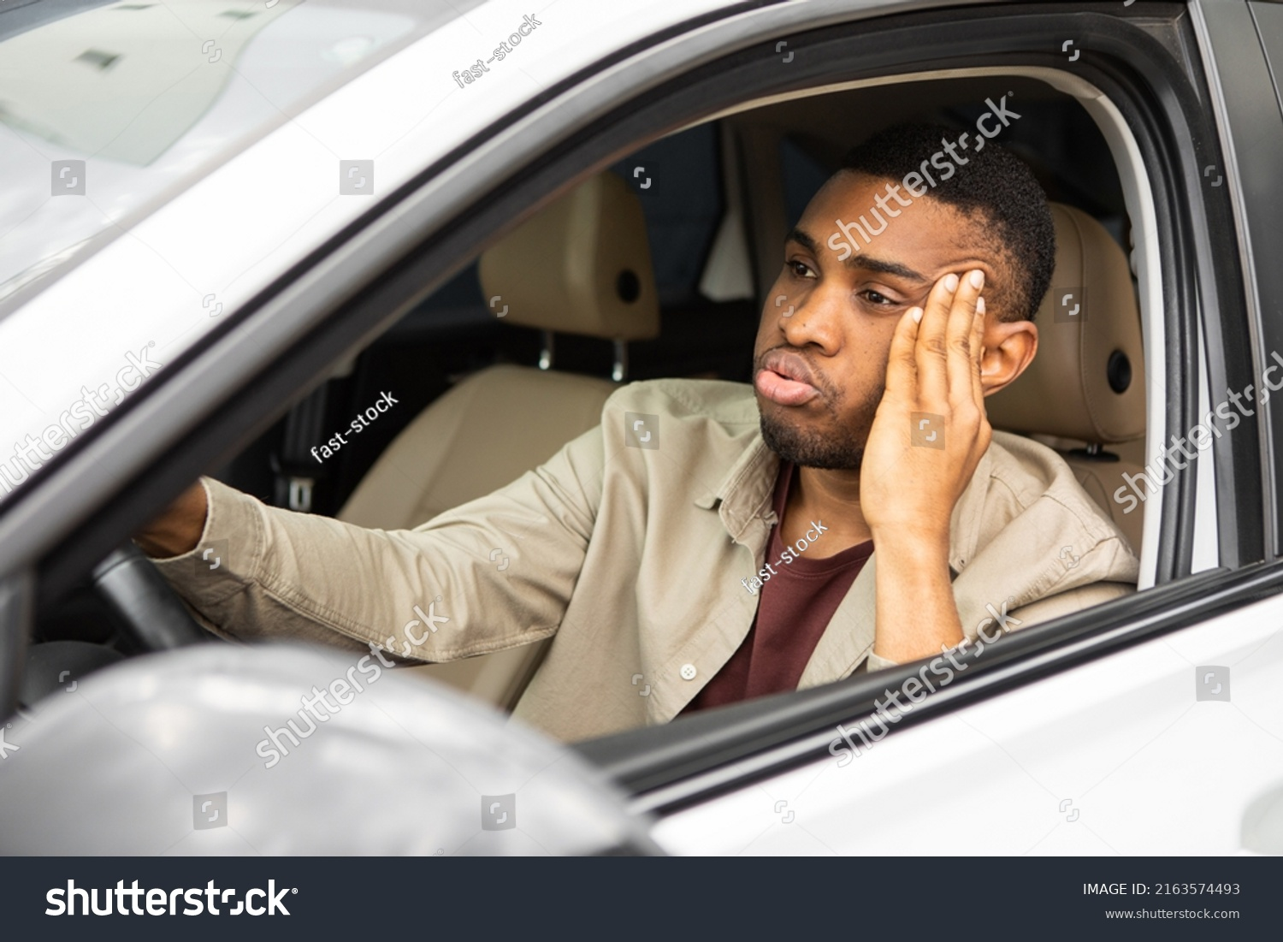
Waiting in line is boring and sometimes unnecessary
Are you the type of person who picks up a coffee every morning? Maybe you’re the type of person who likes to go to taco bell on tuesday nights. Whoever you are this technology will revolutionize the drive-thru industry.

Slide 3
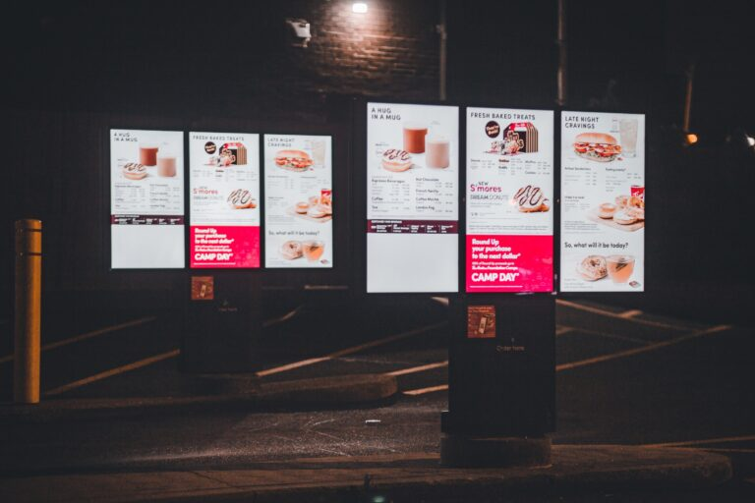
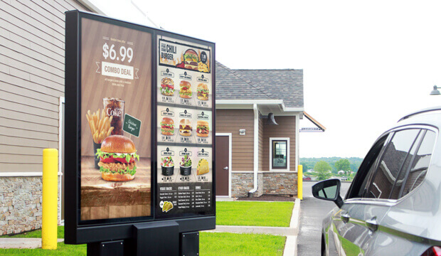
How can we solve this?
Having customer car recognition will greatly expedite customer ordering by allowing the collection of data of the people who pull in. Using that data we could have the option to allow a customer to reorder their last order and even display it. This would also allow a personalized menu based off of purchase history to be displayed to the customer. Using the technology we have to read license plates we can accurately track whoever pulls in to the drive thru by their plate.

Slide 4
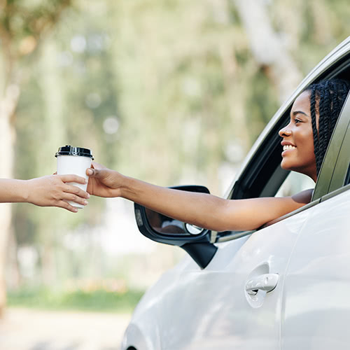
Keeping customers happy
By shortening the time it takes for people to order more people will be more likely to spend their money again. Studies have shown that using digital menus and signage improve the user experience . An example could be showing someone their name and say hello digitally. If someone gets a personalized burger for example the system could track that and it would become the new default for that specific customer.

Slide 5
Pseudocode overview
We will need 3 main parts to achieve customer car recognition and also be able to store data based off their actions.
Read licence plate and check for it in database
If the user has data personalize the menu to their data Else display default menu
Collect data from order and store it for next visit

Slide 6
Checking the value of a license plate
#use sensor to get plate data
Read user plate
Check if plate is in system

Slide 7
Reading the data to provide the best experience
If plate is recognized
Get custom menu
Get order data
Else not in system
Store plate data
Get order data

Slide 8
Custom menu
Access dictionary of user purchases
Greet customer by name
Display pictures of most bought items with most used topping preference
Show previous order and price

Slide 9
Collection and storing of new data
For each item in order
If previous customer
Access dictionary of all items
Add each item to total items bought for user
Else
Create dictionary of items for customer
Add each item to total items bought for user

Slide 10
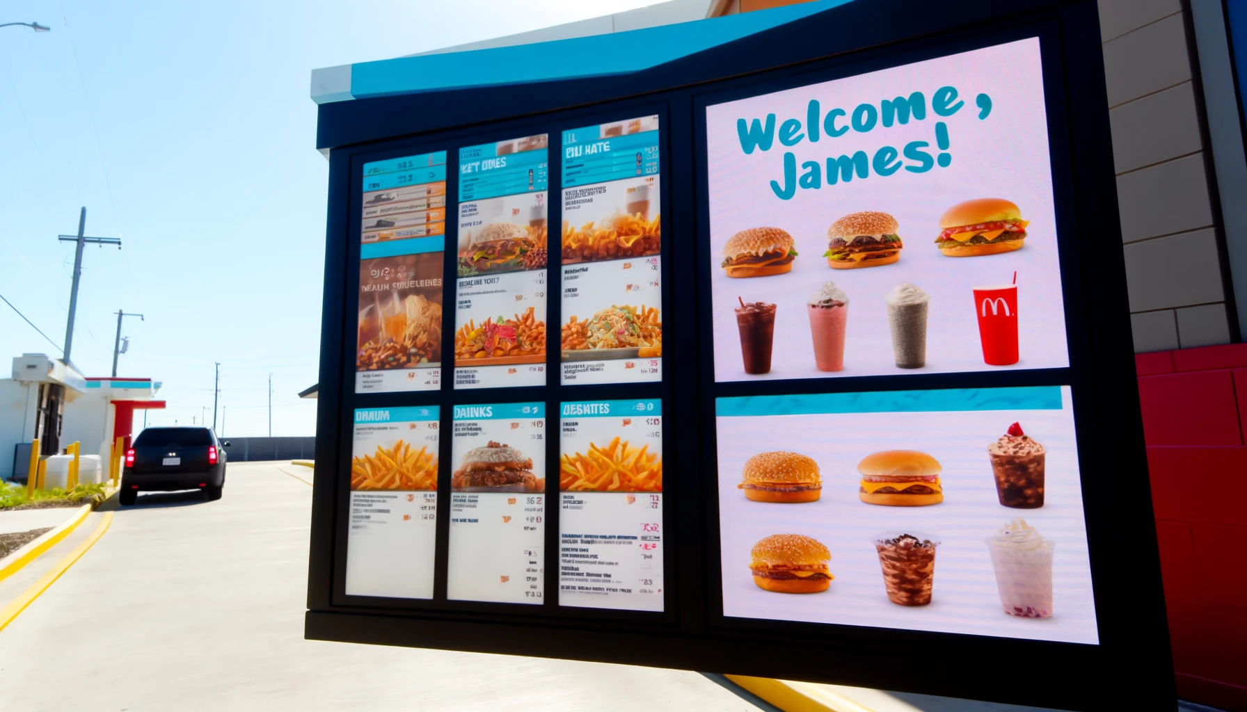
Why we need this
Having a more fluid drive thru experience is in the best interest of consumers and as a company. Happier customers lead to returning customers which is who our system is targeting to improve experiences.
Here is an ai image generated by chatgpt showing a customer greeting.

Slide 11
Questions & Concerns
Questions of privacy have come up and i ask how is that data being stored any different than a hard working employee remembering a loyal customers preferences and eating habits. However if there are legal concerns about this proposition they should be carefully considered and looked at.

Slide 12
Citation
Munn, Luke. "Staying at the Edge of Privacy: Edge Computing and Impersonal Extraction." Media and Communication, vol. 8, no. 2S2, 20 Apr. 2020, pp. 270+. Gale In Context: Opposing Viewpoints, dx.doi.org/10.17645/mac.v8i2.2761. Accessed 7 May 2024.
"Wendy's is testing AI-powered drive-thrus." Spectator [Hamilton, Ontario], 11 May 2023, p. A14. Gale In Context: Opposing Viewpoints, link.gale.com/apps/doc/A775808769/OVIC?u=pima_main&sid=bookmark-OVIC&xid=c43b2820. Accessed 7 May 2024.
Felix, Adrian K., Kelly Ruane Melchiondo, and Megan Barney. "Consumer Data Collection and Privacy: Best
Practices and Risk Mitigation Strategies for Franchise Systems." Franchise Law Journal 42.4 (2023): 435-50. ProQuest. Web. 8 May 2024.
Udler, Carl. "THREE WAYS TO ELEVATE THE DRIVE-THRU EXPERIENCE WITH DIGITAL SIGNAGE: As the restaurant industry continues to rebound from the pandemic, enticing consumers with convenience, ordering ease and speed has become an indispensable recovery strategy." Franchising World, vol. 56, no. 1, Feb. 2024, pp. 60+. Gale OneFile: Health and Medicine, link.gale.com/apps/doc/A784073405/HRCA?u=pima_main&sid=googleScholar&xid=31ef6870. Accessed 9 May 2024.
Drive-Thru Vehicle Detection Is Shaping the Future of Customer Experience | Verizon Business

